Slide 1
CA ERFO NP DEVA 2022-1(2) Salt Creek Interpretive Trail
Amanda Peters, CFLHD Hydraulic Engineer
*Unless otherwise noted, FHWA is the source of all images in this presentation

Slide 2
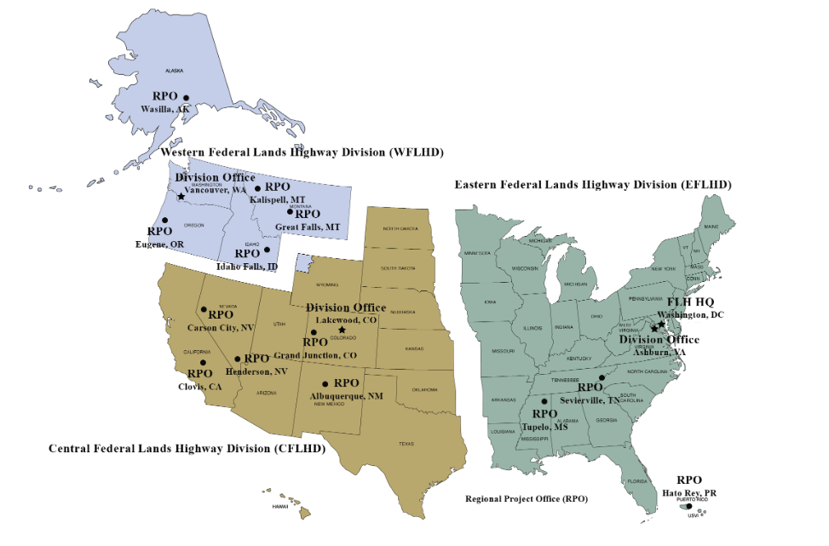
CFL and ERFO Program
CFL: Central Federal Lands
Main Funding Source: ERFO Program
Emergency Relief for Federally Owned Roads
Intent: Restore facilities to pre-disaster condition

Slide 3
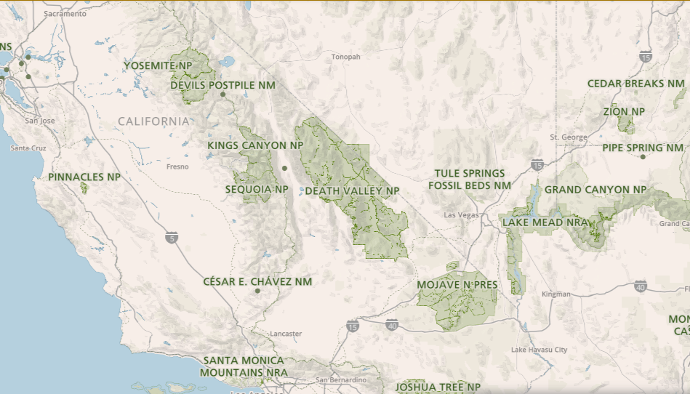
Project Location
Salt Creek Interpretive Trail
Source: https://www.nps.gov/deva/planyourvisit/maps.htm

Slide 4
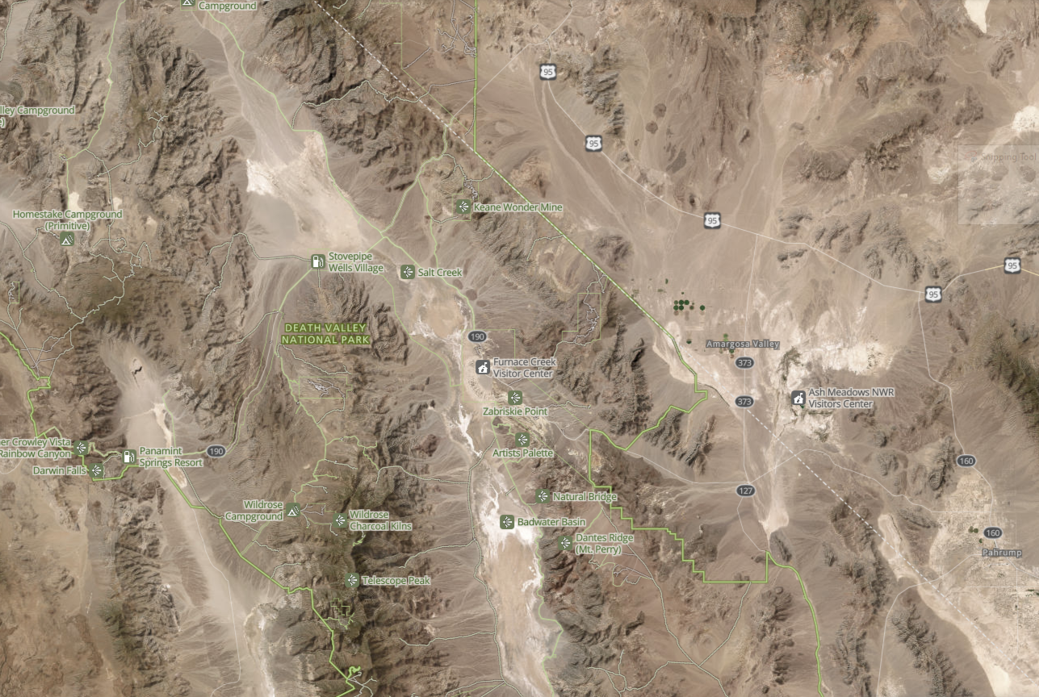
Project Location
Source: https://www.nps.gov/deva/planyourvisit/maps.htm

Slide 5
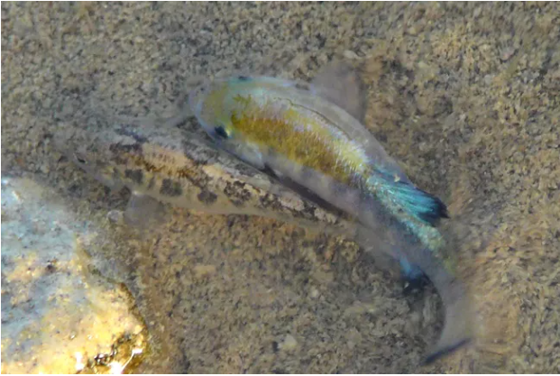
Project Significance
Salt Creek Pupfish
~1.5 in long
Provide educational opportunities while protecting sensitive habitat
Source: https://www.nps.gov/deva/learn/nature/fish.htm

Slide 6
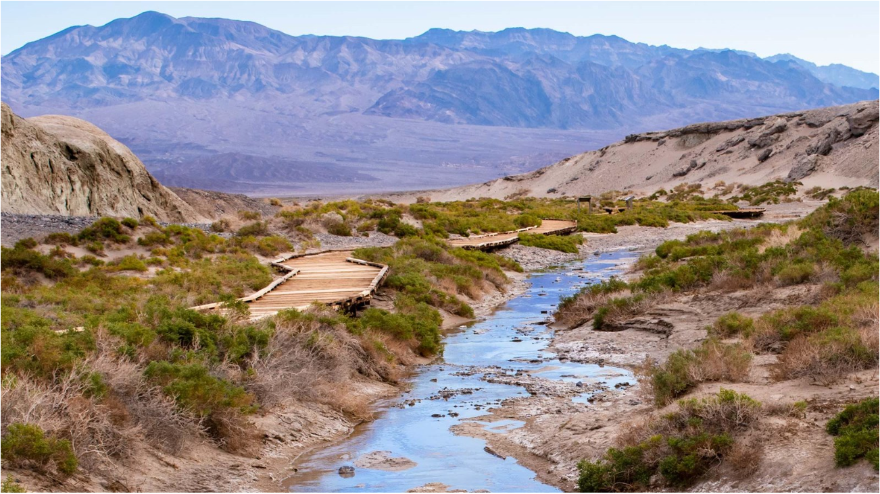
Pre-Disaster Conditions
Source: https://www.nps.gov/places/salt-creek.htm

Slide 7
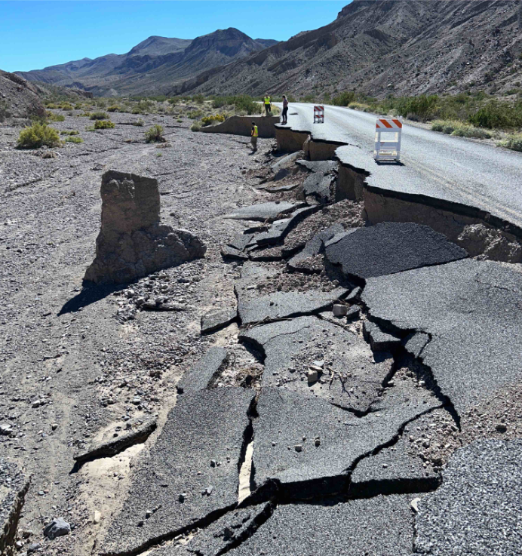
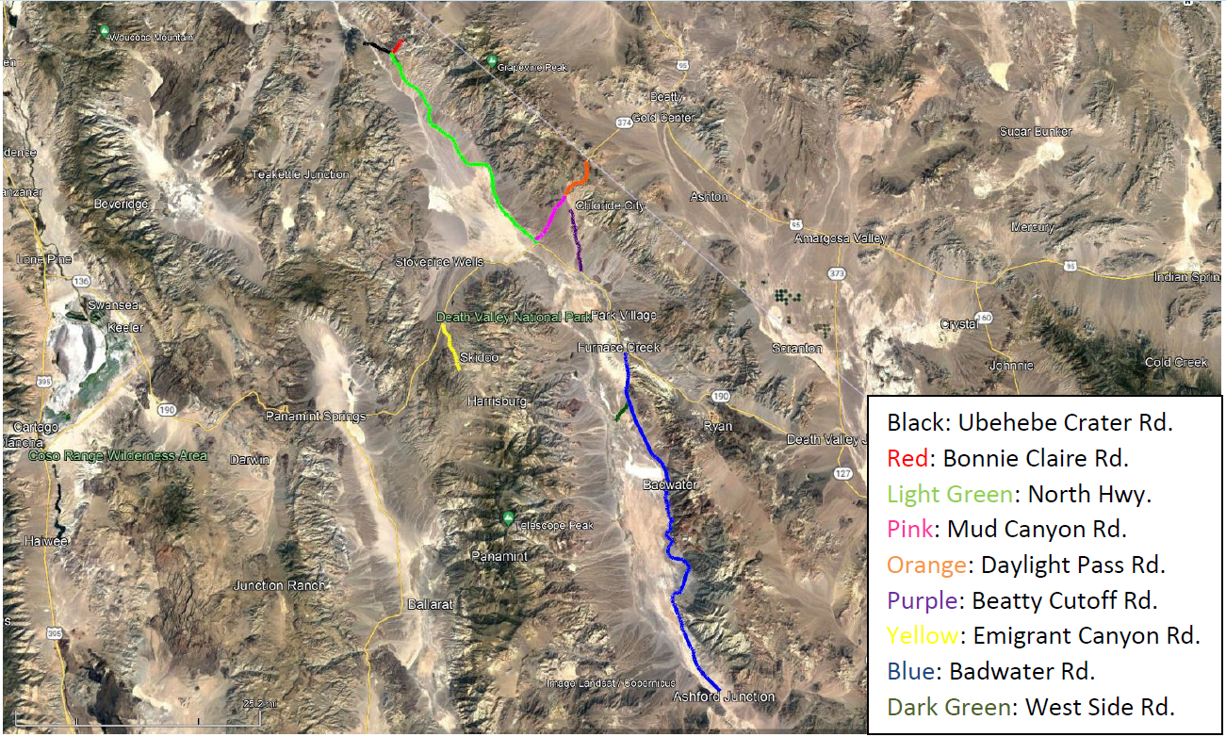
Disaster Events
August 2022: Flash Flooding
Single Day Rainfall: 1.7 in
August 2023: Tropical Storm Hilary
Single Day Rainfall: 2.2 in
Average Annual Rainfall in DEVA: 2 in
Significant damage throughout DEVA

Slide 8
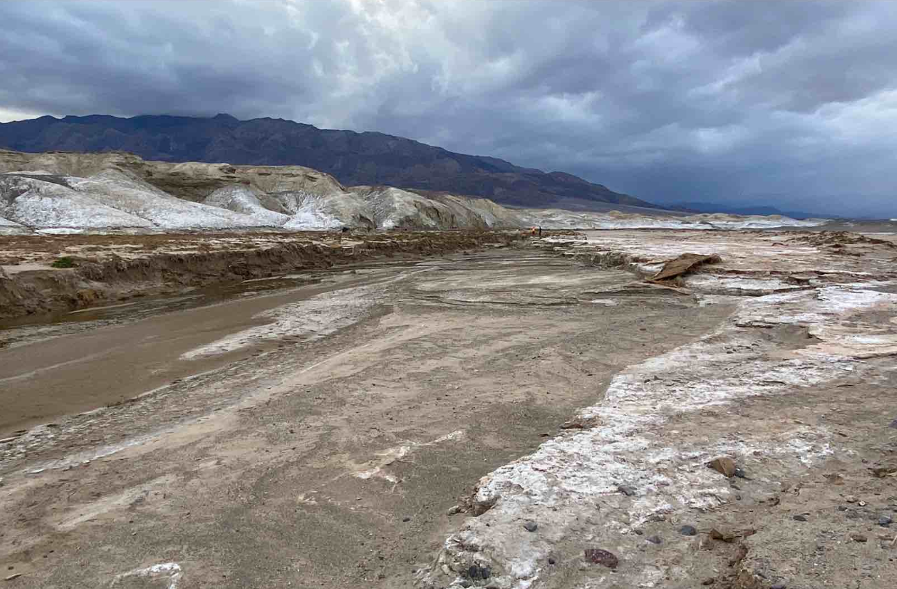
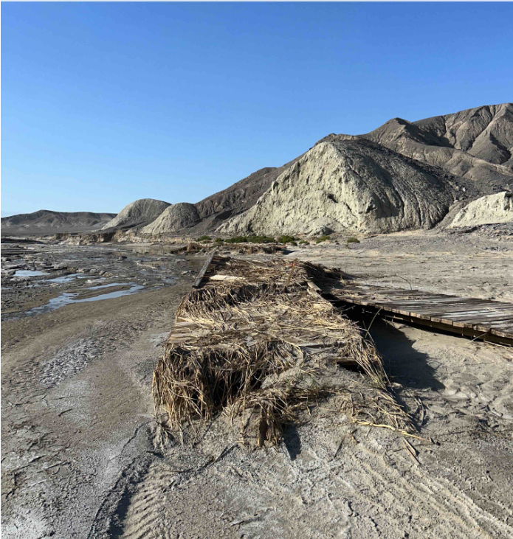
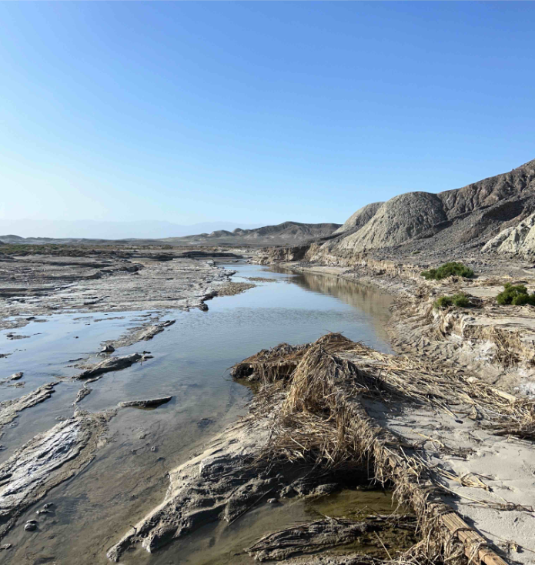
Post-Disaster Conditions

Slide 9
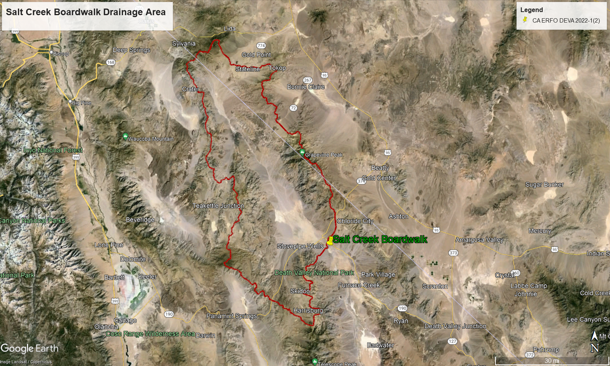
Salt Creek Drainage Basin
Approximately 1500 sqmi. drainage basin
Outfall: Badwater Basin
Annual Exceedance Probability (%) | Return Period (Year) | Computed Flow (cfs)
50 | 2 | 20
20 | 5 | 100
10 | 10 | 240
4 | 25 | 630
2 | 50 | 1,180
1 | 100 | 2,110
0.5 | 200 | 3,620
0.2 | 500 | 7,040
Source: Google Earth

Slide 10
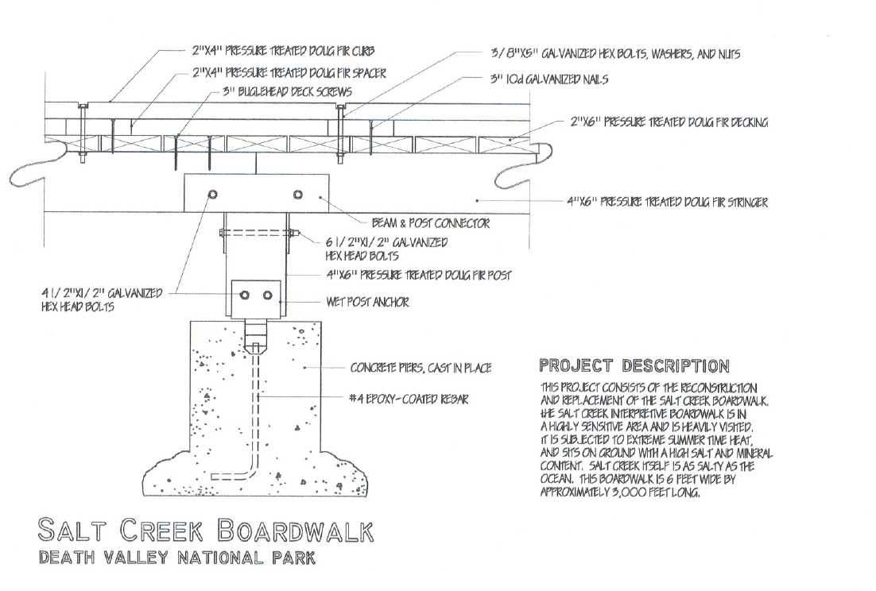
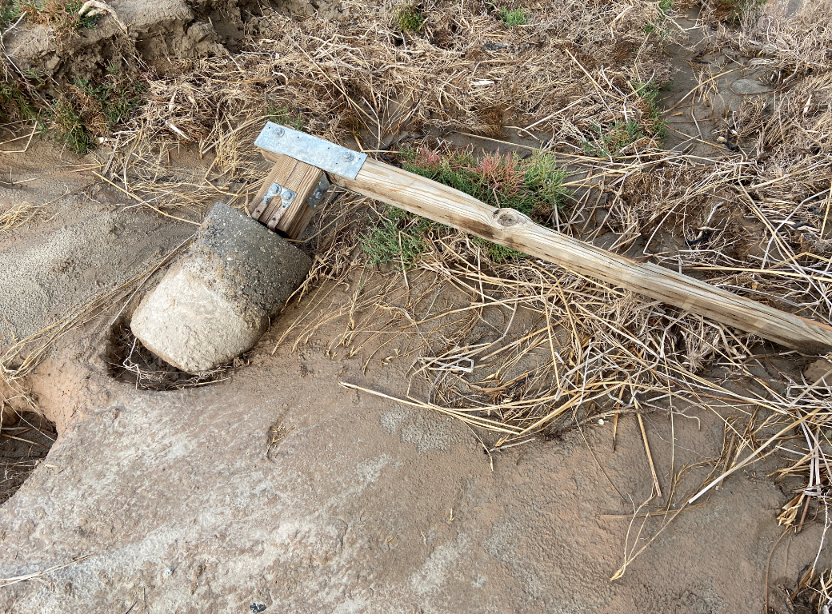
Former Boardwalk
Originally Built: 1976
Most Recent Boardwalk Built: 1997
Cast in Place Concrete Piers
Douglas Fir Decking
Source: NPS

Slide 11
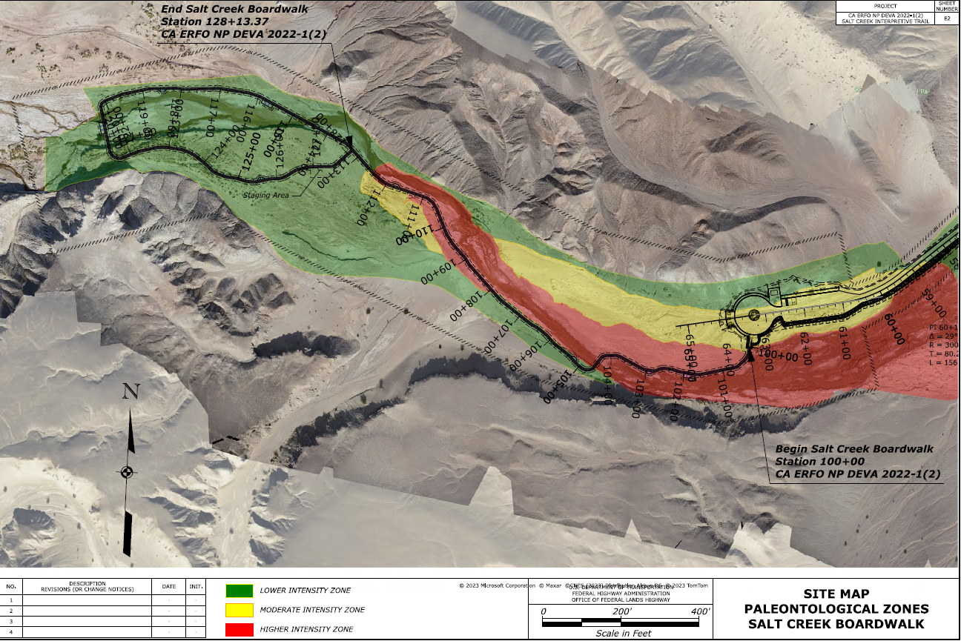
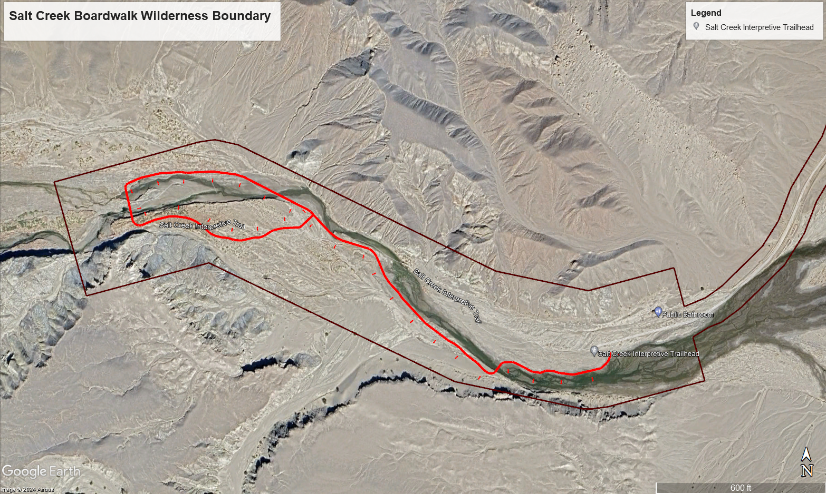
Project Constraints

Slide 12
Design Approach & Criteria
Hydraulic Capacity Design Event: 25 yr (no pressure flow)
Scour Design Event: 50 yr
Scour Check Event: 100 yr

Slide 13
Boardwalk Capacity Design
Ensure the boardwalk is not under pressure flow for the 25 yr event
SMS Version 13.2.17
SRH-2D: Flow and Sediment
Flow

Slide 14
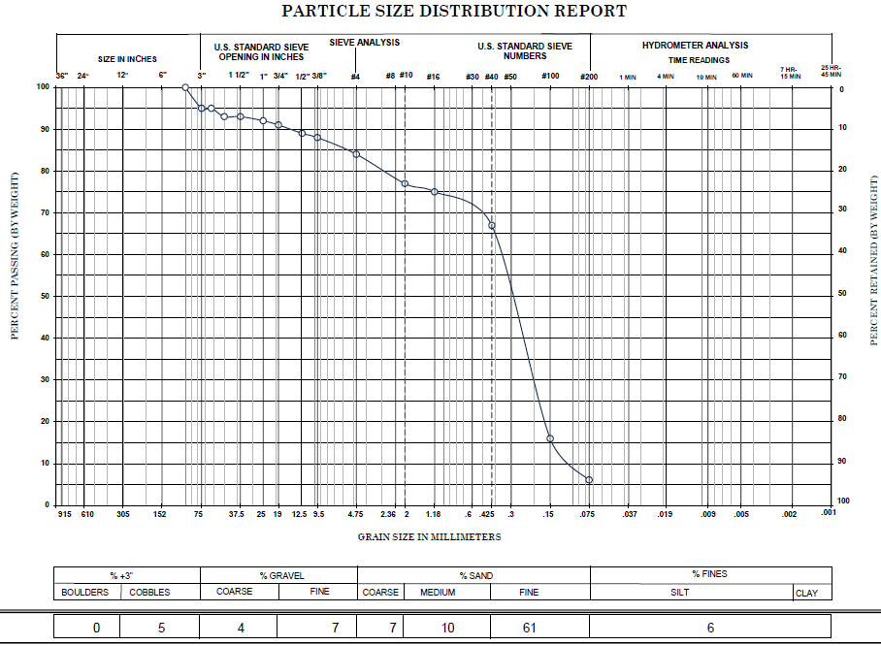
Sediment Transport – Model Development
Sandy Streambed Material
Wide floodplain and zone of sediment movement

Slide 15
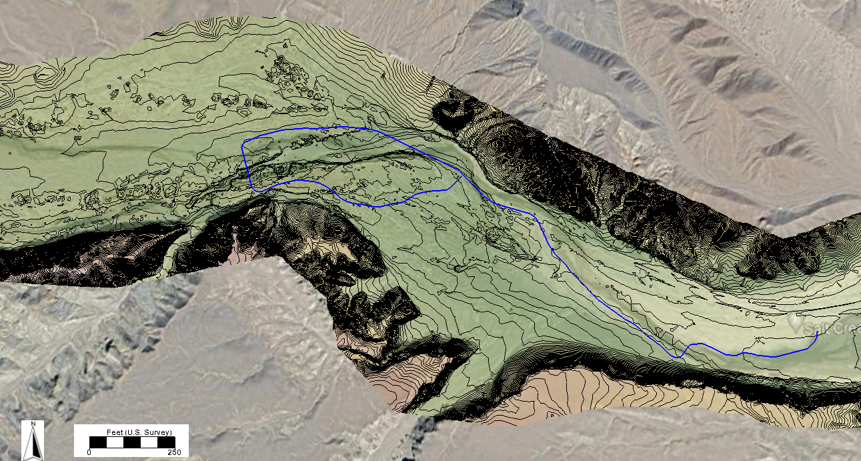
Topographic Comparison
October 2022
October 2023

Slide 16
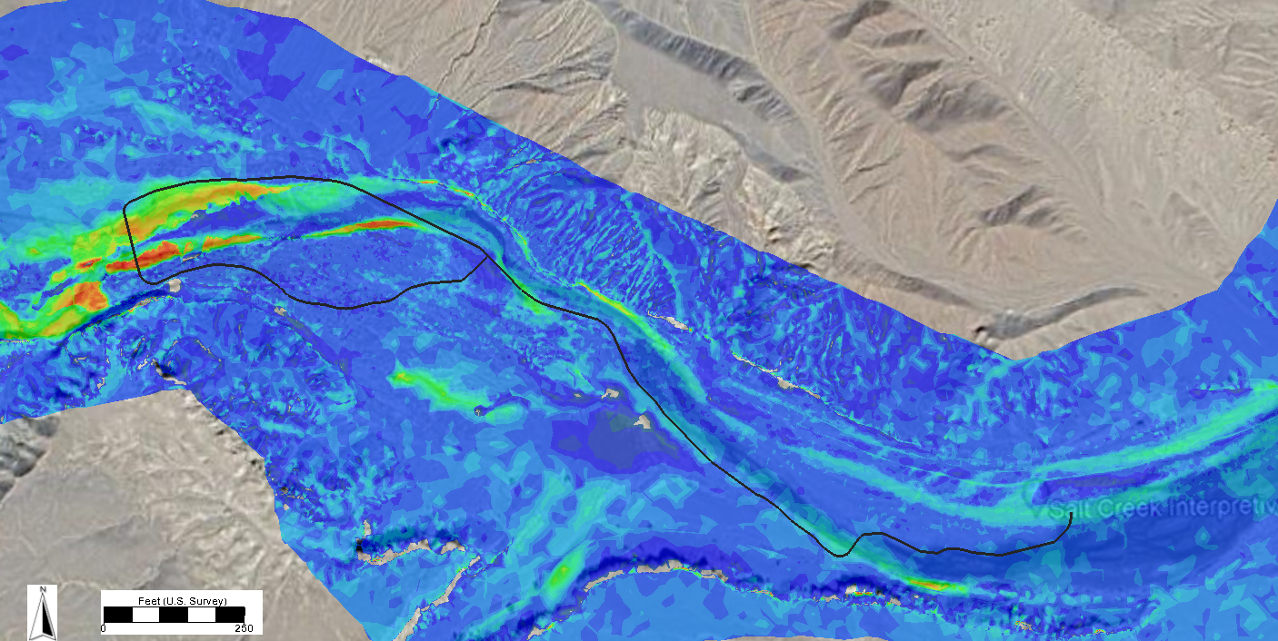
Sediment Transport Comparison
Flow
Flow
LiDAR Comparison: 2022-2023
Pre-Tropical Storm Hilary Sediment Transport Results (100 yr)

Slide 17
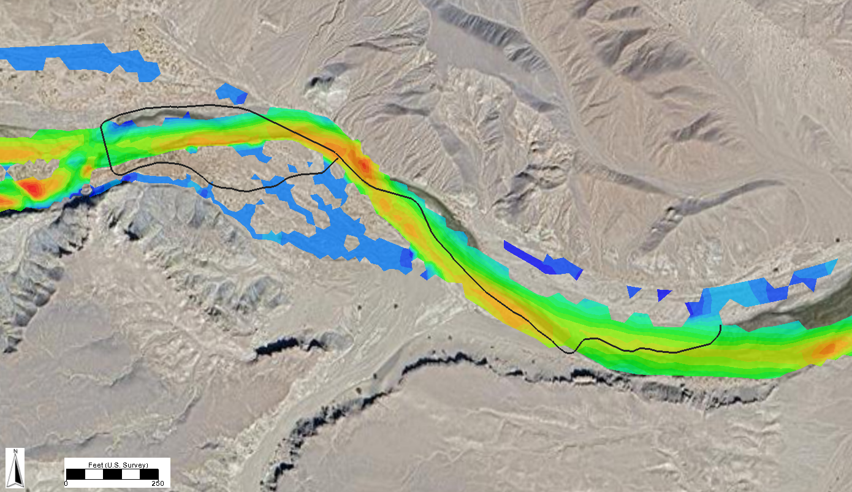
Post-Hilary Sediment Transport
Flow
Post-Tropical Storm Hilary Sediment Transport Results (100 yr)

Slide 18
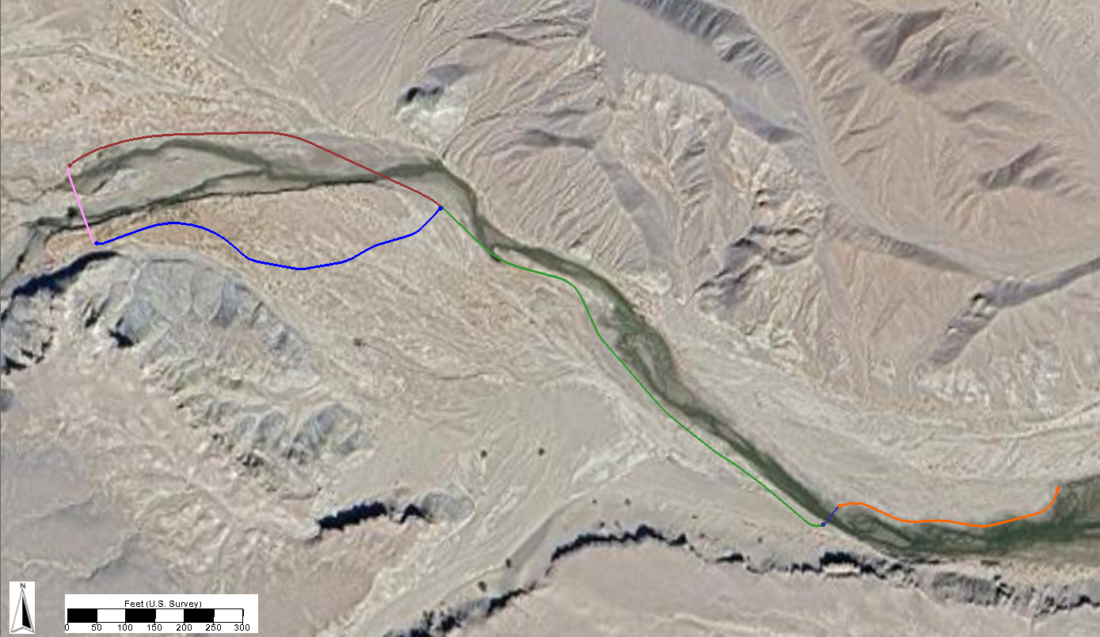
Scour Zones
Scour Zones 1, 2, 3 & 4: 5-$1/2$” Helical Pile
Scour Zone 5: 7” Helical Pile
Scour Zone 6: 2-$7/8$” Helical Pile
Scour Zone 4
Scour Zone 3
Scour Zone 5
Scour Zone 6
Scour Zone 2
Scour Zone 1

Slide 19
Helical Pile Scour
HEC-18 Pier Scour Equation (non-standard approach)
Scour Design Event: 1.2 x single helical pile scour depth
Scour Check Event: Debris considerations (wall pier)

Slide 20
Scour Results
Combination of sediment transport model results and local (pier) scour
Hydraulic Data
Scour Zone | 50-yr Storm Total Scour (Ft) | 50-yr Maximum Velocity (fps) | 100-yr Storm Total Scour (Ft) | 100-yr Maximum Velocity (fps)
1 | 6.0 | 6.7 | 7.0 | 7.9
2 | 5.5 | 4.3 | 7.0 | 5.4
3 | 5.5 | 10.0 | 7.5 | 12.3
4 | 6.0 | 4.6 | 7.0 | 5.8
5 | 5.5 | 7.1 | 7.0 | 7.9
6 | 1.0 | 1.0 | 1.5 | 6.5

Slide 21
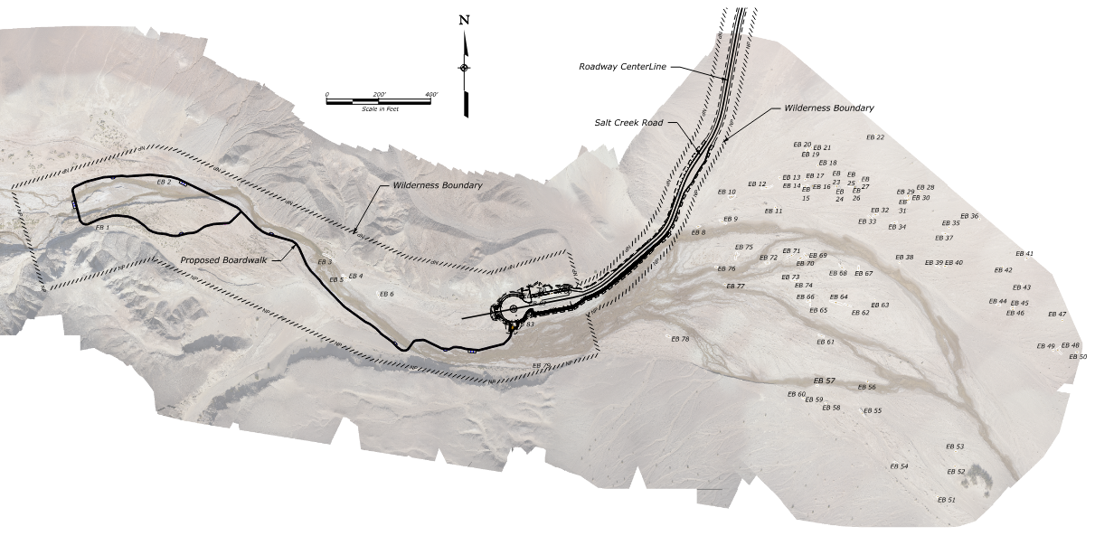
Existing Boardwalk Removal

Slide 22
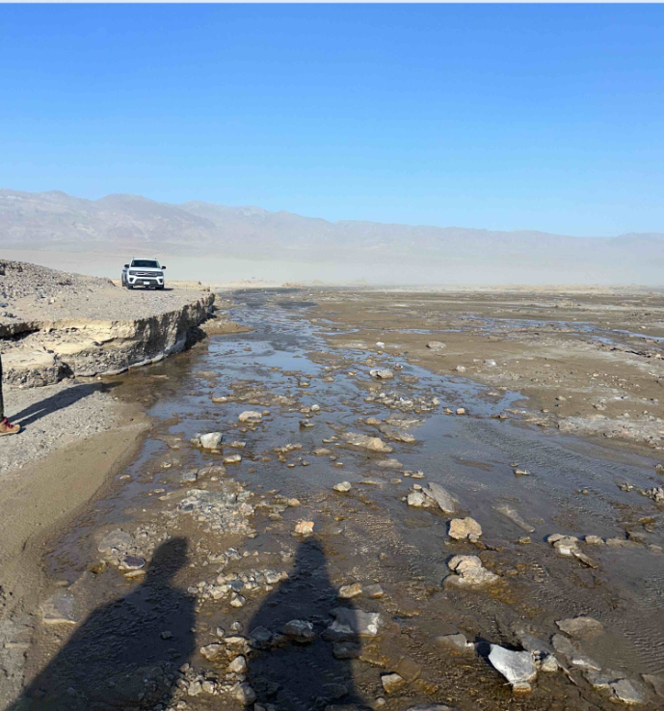
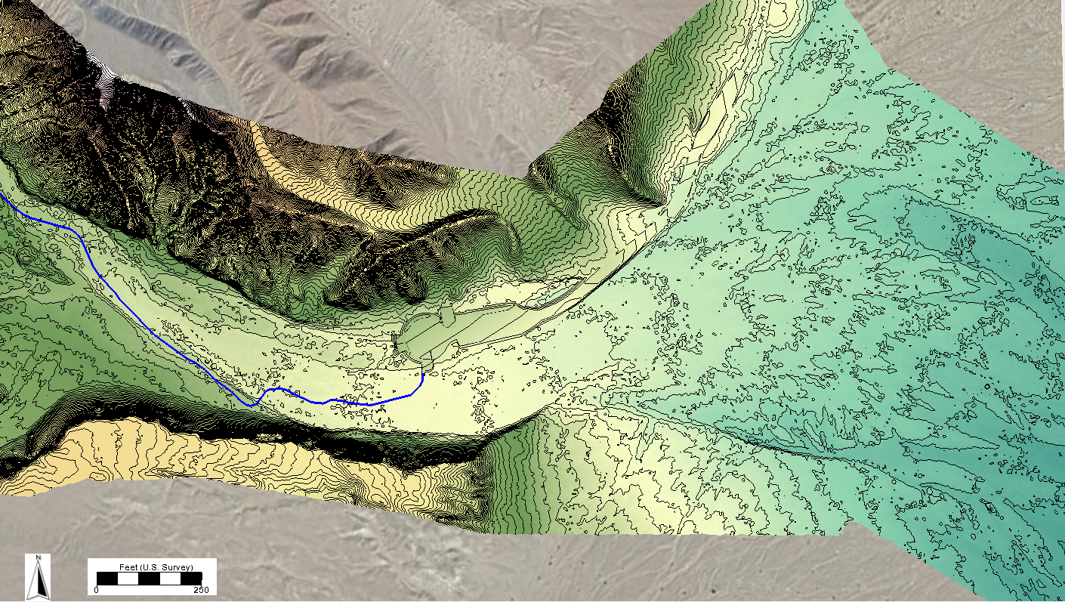
Salt Creek Road
Road and parking area raised to avoid inundation by 25 year event
Embankment Protection

Slide 23
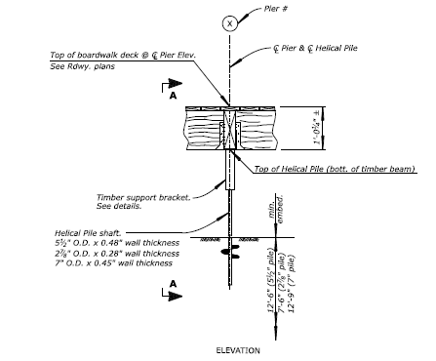
Conclusion
SRH-2D used for hydraulic modeling and sediment transport
Proposed Boardwalk: Helical piles with Douglas Fir decking
Anticipated Construction Start: December 2024
Anticipated Construction Completion: May 2025

Slide 24
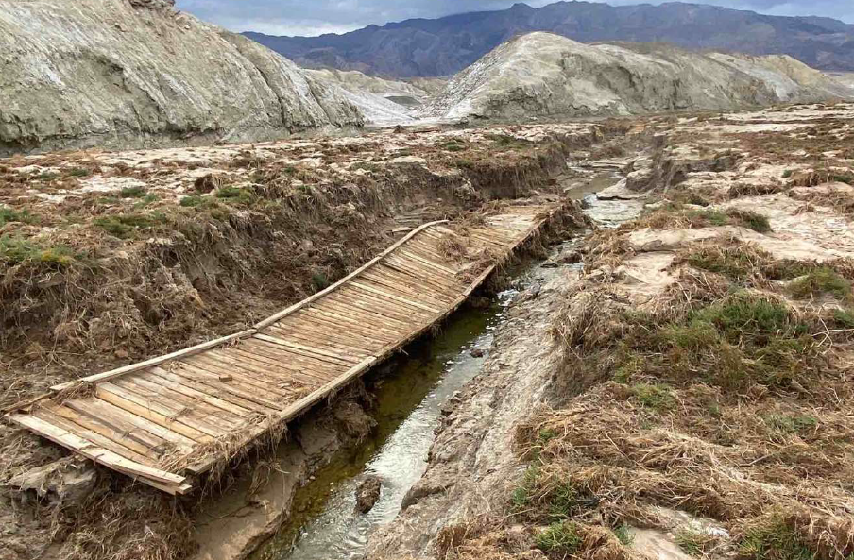
Questions?

